Slide 1
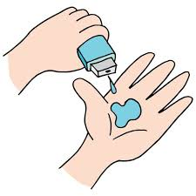
Health & Insurance Analysis
Priyanshu Prakash
AICTE Internship Student Registration ID) : STU66a2887877ab71721927800
Magadh University
Computer Application 4th year

Slide 2

PROBLEM STATEMENT
Identify the number of duplicate records and examine missing values in the dataset.
Analyze the distribution of illness, including counts by gender, and visualize people’s access to various health insurance types.
Evaluate income characteristics, including maximum, minimum, and median levels, and how income affects hospital visits.
Investigate correlations between variables, focusing on factors such as illness, reduced activity, and health status.
Visualize key relationships like gender-wise illness, reduced activity due to illness, and the relation between health status and activity reduction.

Slide 3
Project Description
We analyzed a dataset of 5,190 people to understand how factors like age, income, and insurance affect health. We cleaned the data, explored patterns, and visualized findings.
Our goal is to use these insights to improve healthcare access, reduce costs, and promote healthier lifestyles. We believe this analysis can contribute to better healthcare policies and practices.

Slide 4

WHO ARE THE END USERS?
Healthcare providers can use our findings to identify trends in patient visits and provide their services accordingly.
Providers can identify trends in patient visits, policymakers can understand insurance needs.
Public health researchers can leverage our findings to address disparities in healthcare access

Slide 5

Technology Used
Python: The primary programming language used for data analysis and visualization in this project.
Pandas: A powerful data manipulation library in Python, used for cleaning, organizing, and analyzing the sales and profit data.
Matplotlib: A Python plotting library used to create the bar charts and visualizations
Seaborn: A data visualization library built on top of Matplotlib, used for creating visually appealing

Slide 6
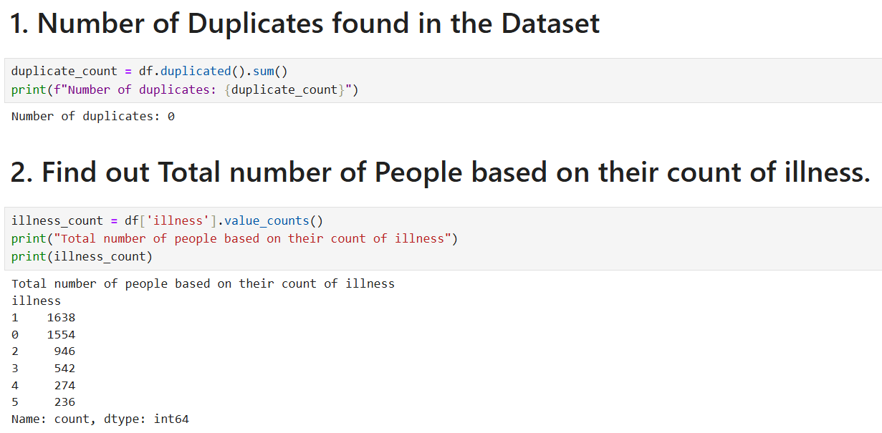
RESULTS
No duplicates in the dataset
Illness levels range from 0-5, with most people having level 1 (1638 people)
Demo Link

Slide 7
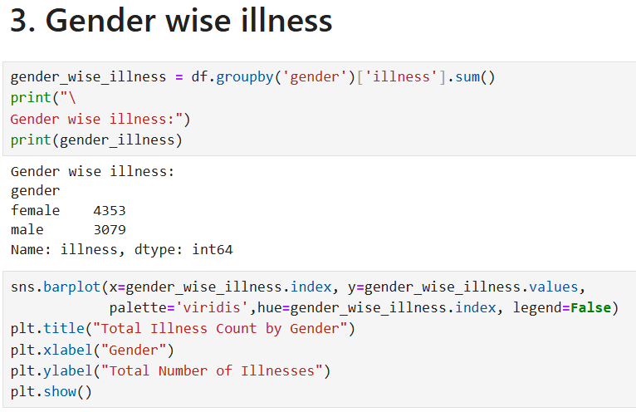
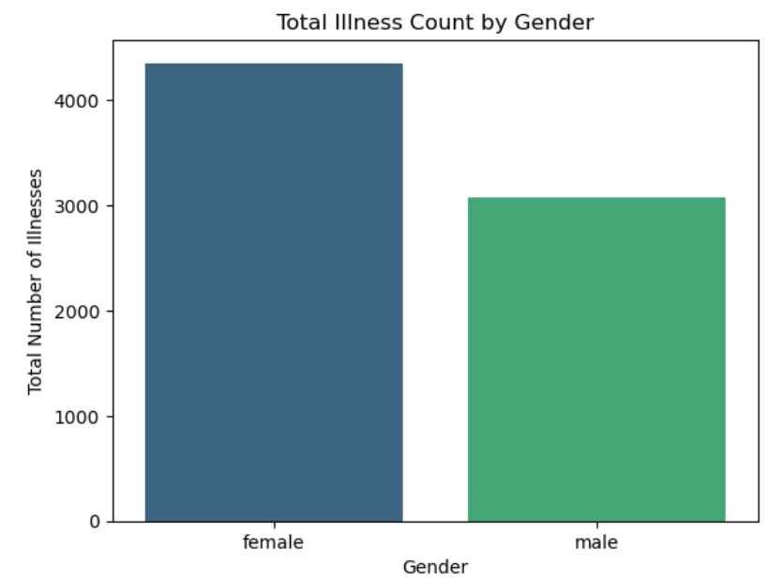

Slide 8
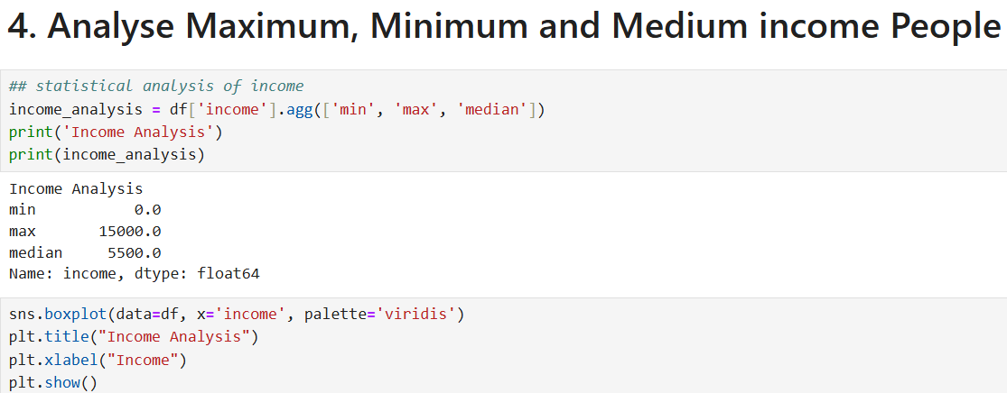
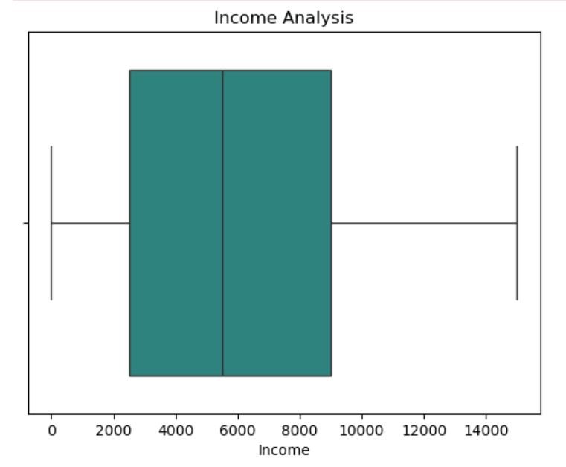
The median income is 0.55, with a range from 0 to 1.5.

Slide 9
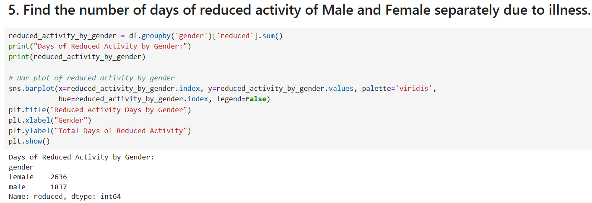
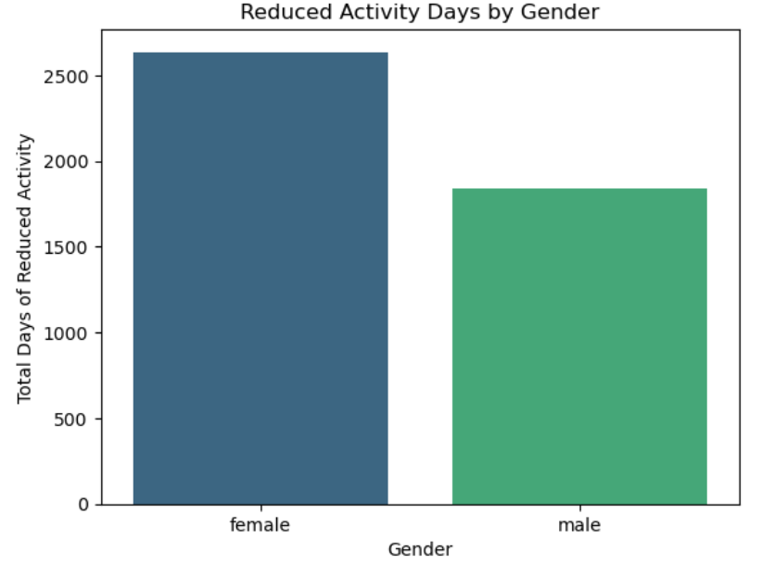
Females have more reduced activity days (2636) compared to males (1837).

Slide 10
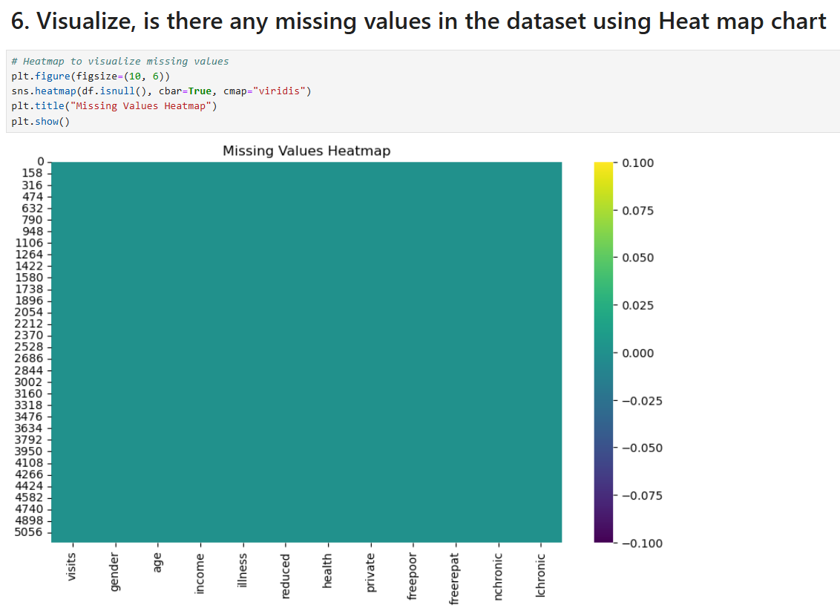
There are no missing values in the dataset, as shown in the above heatmap.

Slide 11
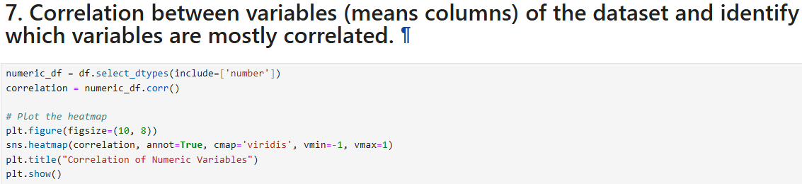
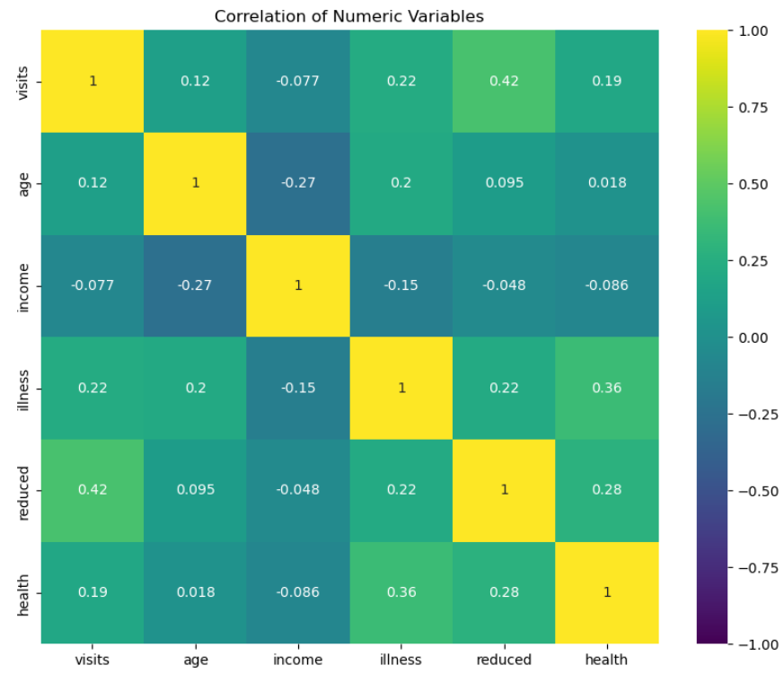
Strong correlations exist between visits and illness, and health status and reduced activity.

Slide 12
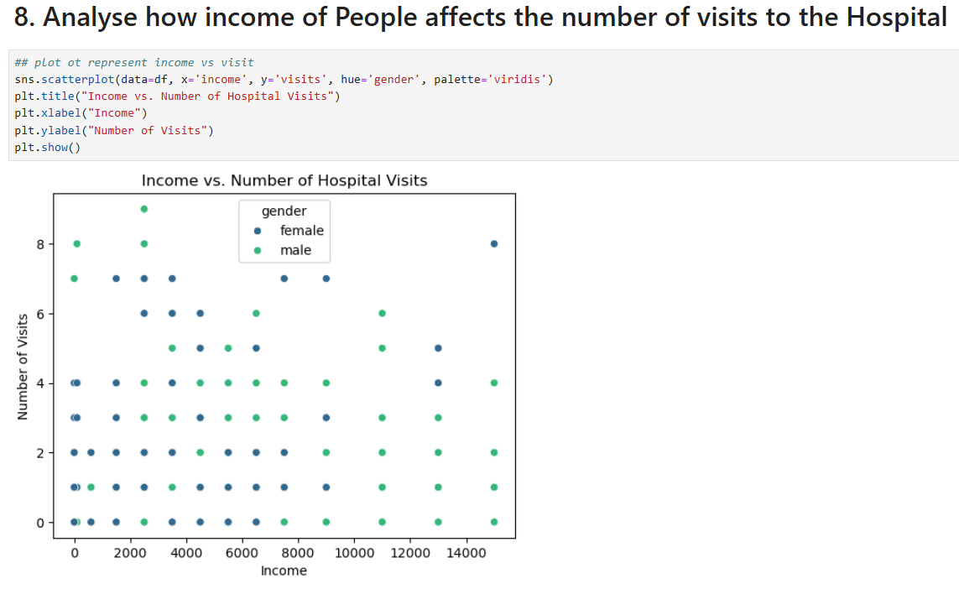
Higher income shows a slight correlation with increased hospital visits.

Slide 13
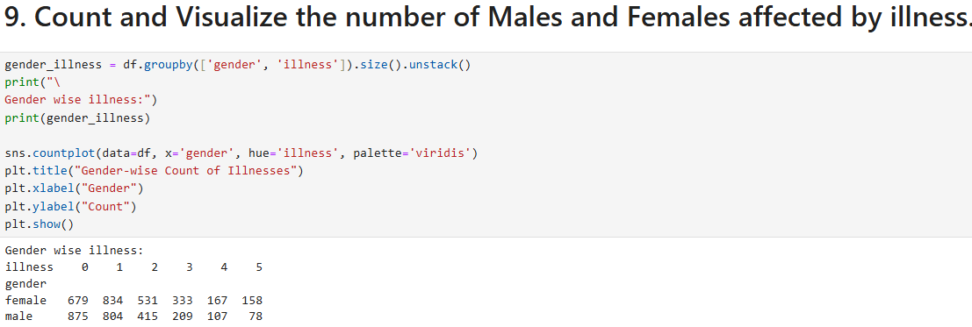
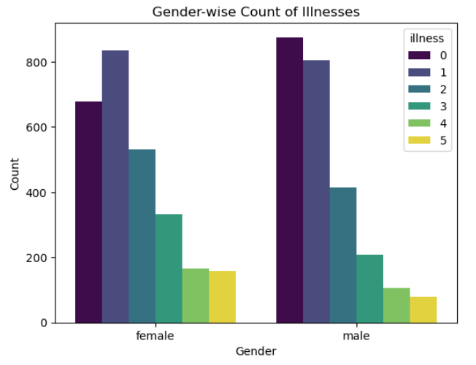
Men and Women get sick differently. Women are more likely to get certain illnesses than men.

Slide 14
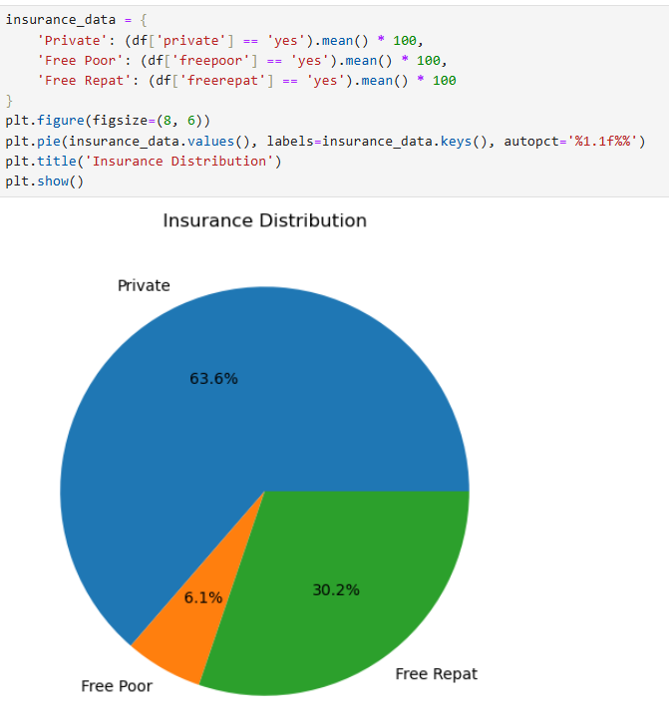
Private insurance is the most common type among the dataset.

Slide 15
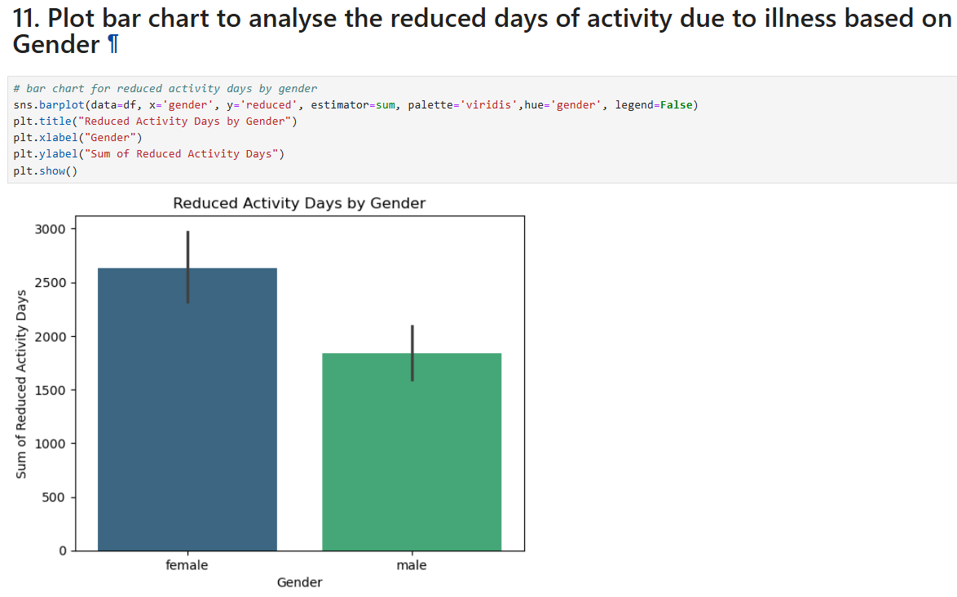
Female have more reduced activity days due to illness.

Slide 16
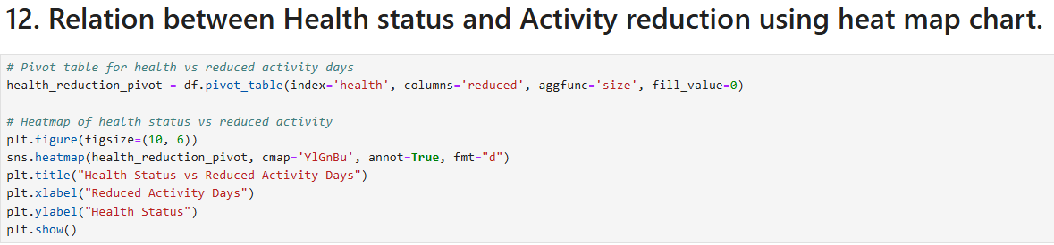
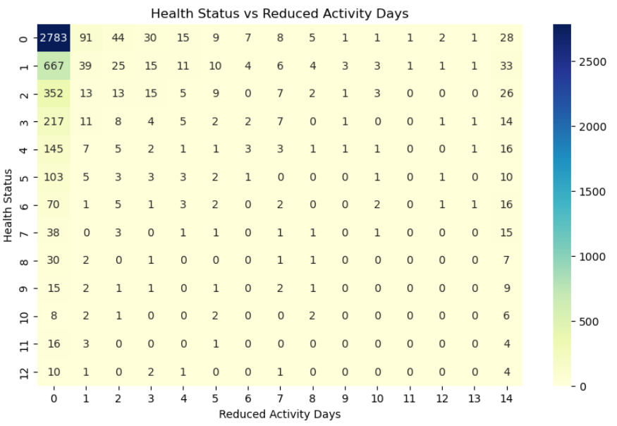
There is a notable relationship between health status and activity reduction.

Slide 17
Conclusion & Recommendations
Conclusion:
The dataset analysis shows that females report higher illness counts and reduced activity days compared to males, with a median income of 0.55.
Strong correlations exist between illness and hospital visits, and health status and activity reduction, indicating that health significantly impacts daily activities.
Recommendations:
Implement targeted health interventions for females to reduce illness impact and improve activity levels.
Encourage higher income individuals to maintain regular health check ups to manage illness effectively.

Slide 18
Thank you
Thank you for your time and consideration; we look forward to your feedback and insights!
.
.

